Slide 1
Object Oriented Programming with Java
Day 11

Slide 2
Understanding Computer Files
Volatile storage
Computer memory or random access memory (RAM)
Temporary
Nonvolatile storage
Not lost when computer loses power
Permanent
Computer file
Collection of information stored on nonvolatile device in computer system

Slide 3
Understanding Computer Files
Permanent storage devices
Hard disks
Zip disks
USB drives
Reels or cassettes of magnetic tape
Compact discs
Categories of files by the way they store data
Text files
Binary files

Slide 4
Understanding Computer Files
Data files
Contain facts and figures
Program files or application files
Store software instructions
Path
A complete list of disk drive plus the hierarchy of directories in which a file resides
When you work with stored files in an application, you perform the following tasks:
Determine whether and where a path or file exists
Open a file
Write information to a file
Read data from a file
Close a file
Delete a file

Slide 5
Using the Path and Files Classes
Path class
Use it to create objects that contain information about files or directories
Files class
Use it to perform operations on files and directories
java.nio.file package
Include it to use both the Path and Files classes

Slide 6
Creating a Path
First, determine the default file system on the host computer
FileSystem fs = FileSystems.getDefault();
Define a Path using the getPath() method
Path path = fs.getPath ("C:\\Java\\Chapter.13\\Data.txt");
Every Path is either an absolute path or a relative path
What is the difference between absolute and relative path?

Slide 7
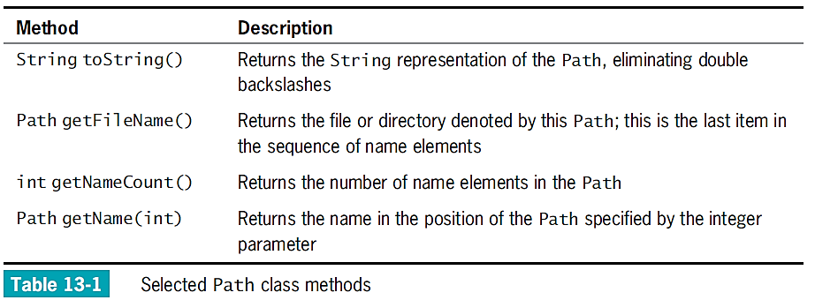
Retrieving Information About a Path

Slide 8
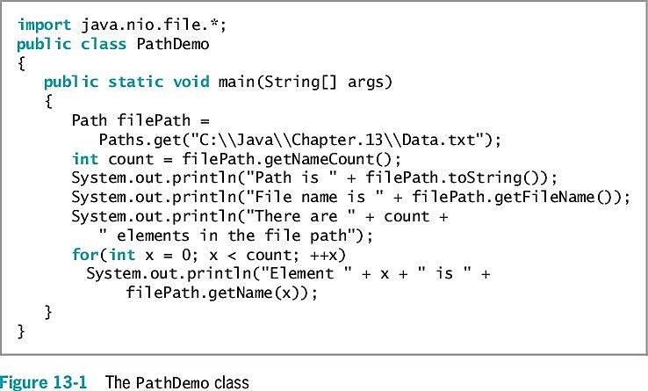
Retrieving Information About a Path
What will this program output?

Slide 9
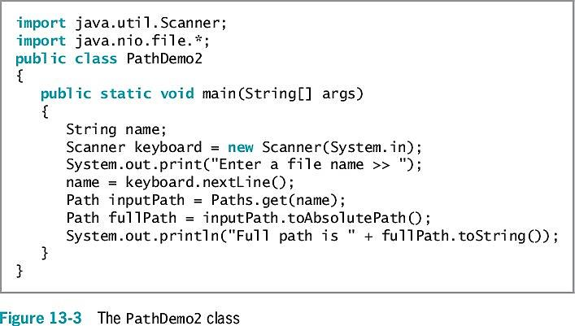
Converting a Relative Path to an Absolute One

Slide 10
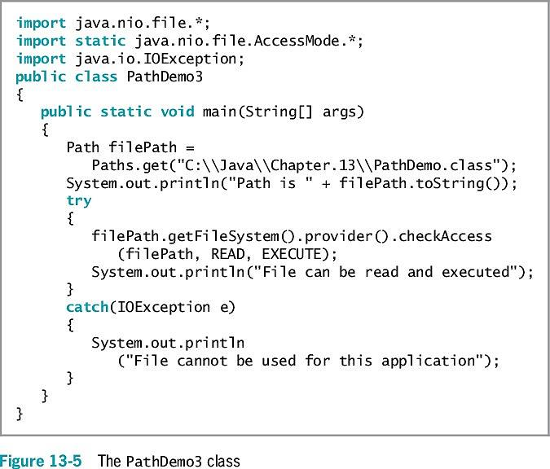
Checking File Accessibility

Slide 11
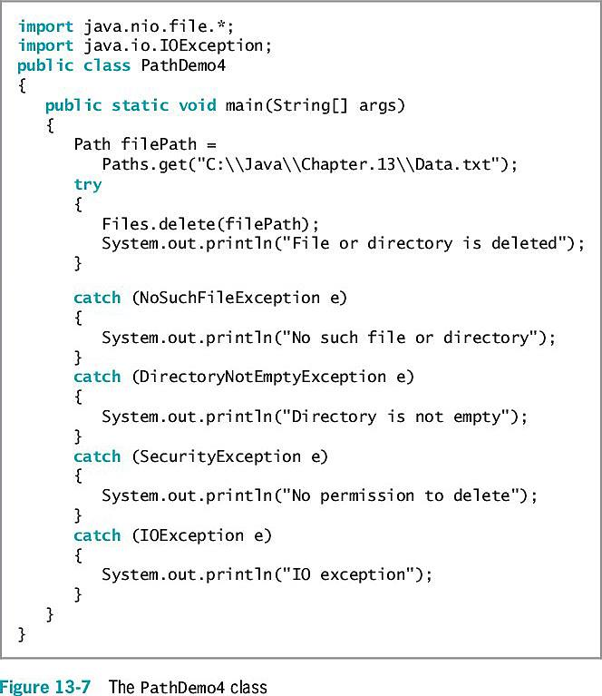
Deleting a Path

Slide 12
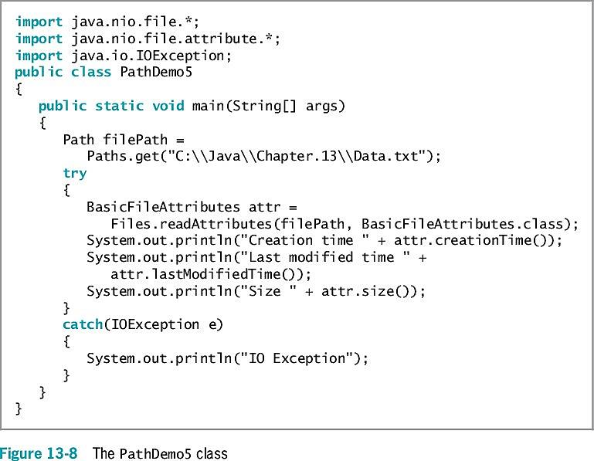
Determining File Attributes

Slide 13
Exercise
Create a file that contains your favorite song lyric. Use a text editor such as Notepad, and save the file. Copy the file contents, and paste them into a word-processing program, such as Word. Write an application that displays the sizes of the two files as well as the ratio of their sizes to each other.

Slide 14
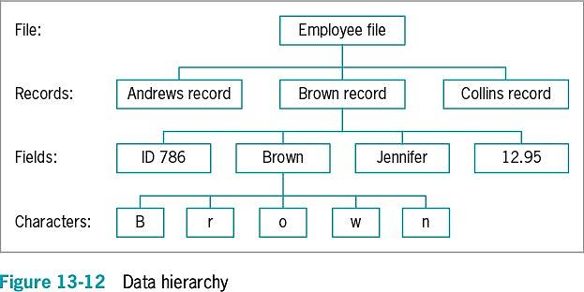
File Organization, Streams, and Buffers
When you need to retain data for any significant amount of time, save it on a permanent, secondary storage device

Slide 15
File Organization, Streams, and Buffers
Open a file
Create object
Associate a stream of bytes with it
Close the file
Make it no longer available to your application
You should always close every file you open
Stream
Bytes flow into your program from an input device
Bytes flow out of your application to an output device
Most streams flow in only one direction

Slide 16
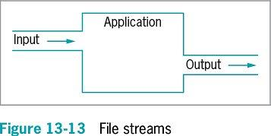
File Organization, Streams, and Buffers

Slide 17
File Organization, Streams, and Buffers
Buffer
Memory location where bytes are held after they are logically output, but before they are sent to the output device
Using a buffer improves program performance
Flushing
Clears any bytes that have been sent to a buffer for output, but have not yet been output to a hardware device

Slide 18
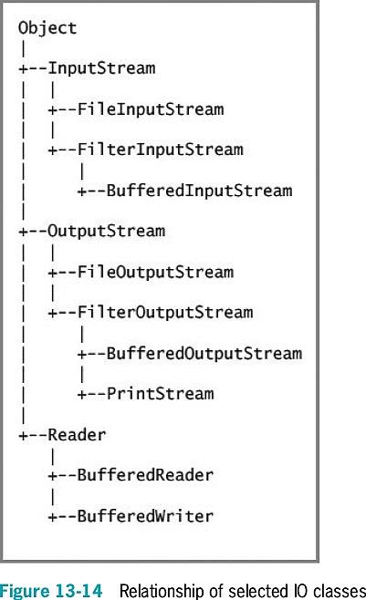
Using Java’s IO Classes
InputStream, OutputStream, and Reader
Abstract classes that contain methods for performing input and output
System.out
PrintStream object
Defined in System class
System.err
Usually reserved for error messages

Slide 19
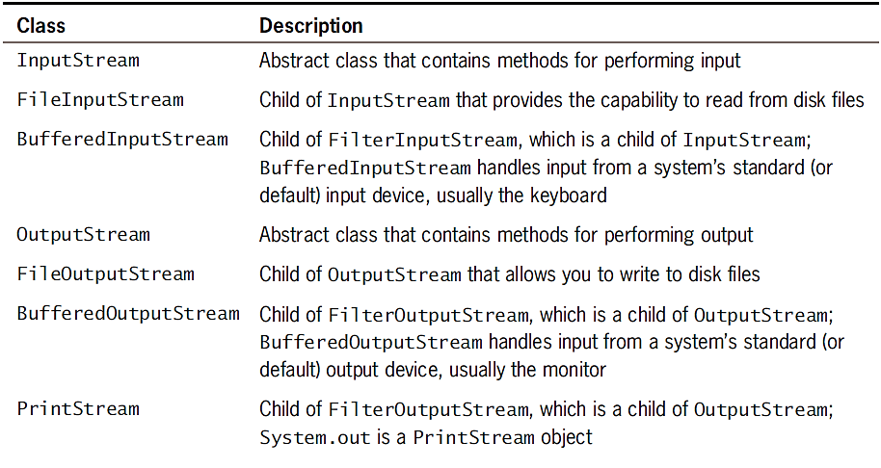
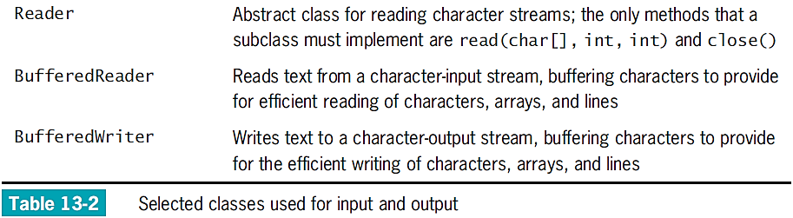
Using Java’s IO Classes

Slide 20
Writing to a File
Assign file to the OutputStream
Construct a BufferedOutputStream object
Assign it to the OutputStream
Create a writeable file by using the Path class newOutputStream() method
Creates a file if it does not already exist
Opens the file for writing and returns an OutputStream that can be used to write bytes to the file

Slide 21
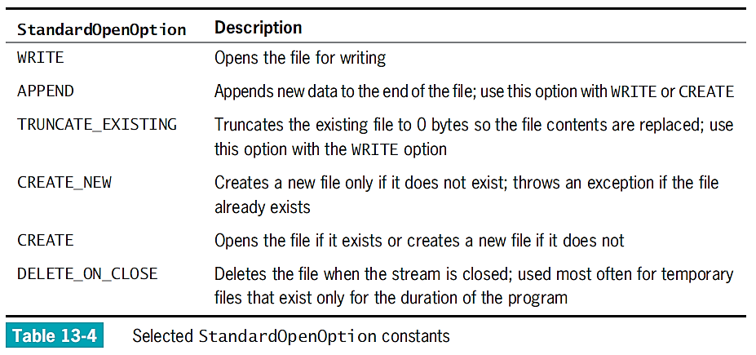
Writing to a File

Slide 22
Reading from a File
Use an InputStream as you would use an OutputStream
Open a file for reading with the newInputStream() method
Returns a stream that can read bytes from a file

Slide 23
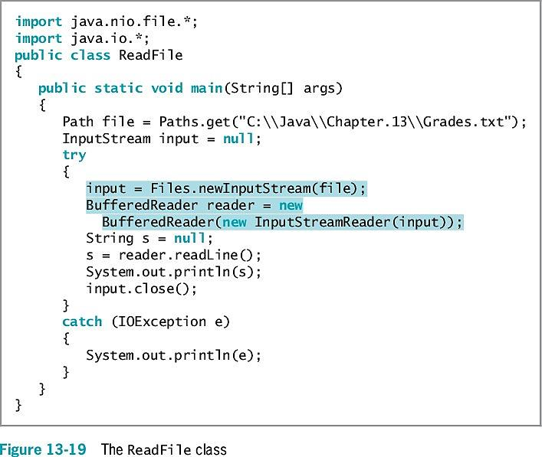

Slide 24
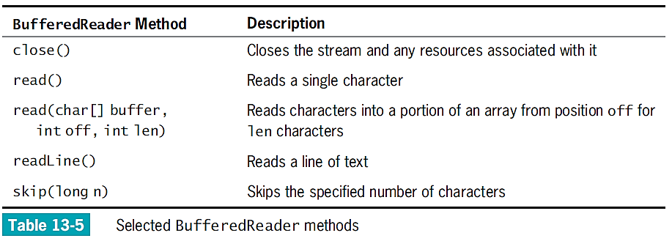
Reading from a File

Slide 25
Creating and Using Sequential Data Files
BufferedWriter class
Counterpart to BufferedReader
Writes text to an output stream, buffering the characters
The class has three overloaded write() methods that provide for efficient writing of characters, arrays, and strings, respectively

Slide 26
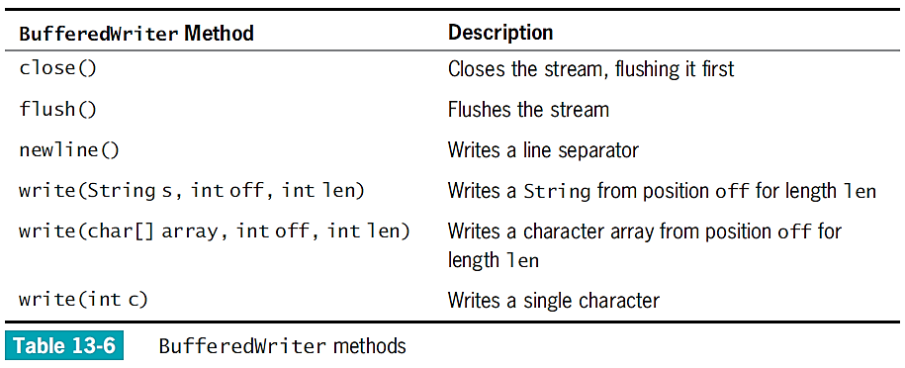
Creating and Using Sequential Data Files

Slide 27
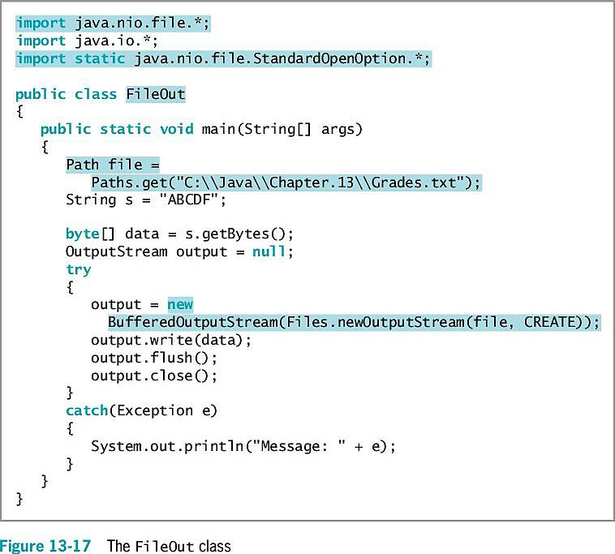
Writing to a File
What does this program do?
What if the file Grades.txt already existed and had content?
Implement this program to check your answer.

Slide 28
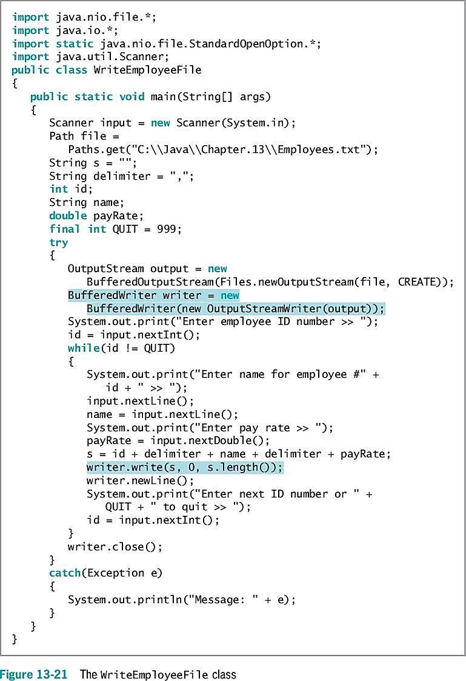
What does this program do?
Implement this program to check your answer.

Slide 29
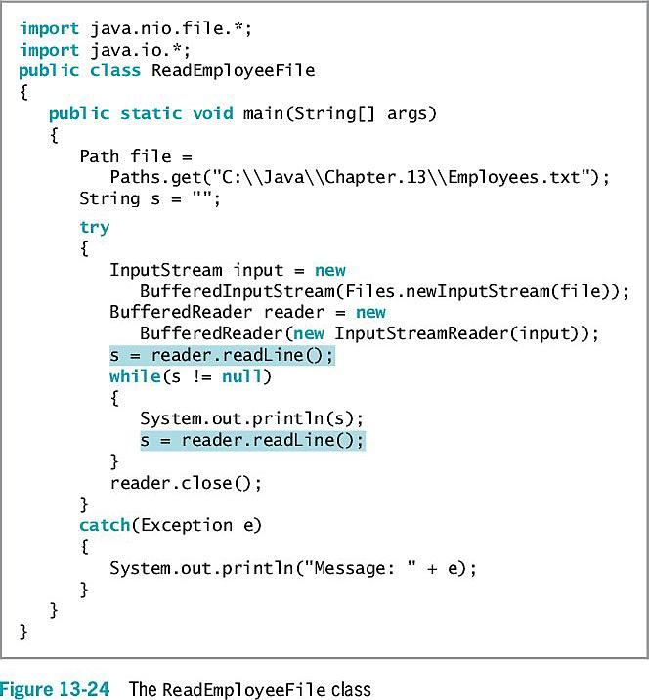
What does this program do?
Why is it important to use the try/catch block?

Slide 30
Learning About Random Access Files
Sequential access files
Access records sequentially from beginning to end
Good for batch processing
Same tasks with many records one after the other
Inefficient for many applications
Real-time applications
Require immediate record access while client waits

Slide 31
Learning About Random Access Files
Random access files
Records can be located in any order
Also called direct access files or instant access files
File channel object
An avenue for reading and writing a file
You can search for a specific file location, and operations can start at any specified position
ByteBuffer wrap() method
Encompasses an array of bytes into a ByteBuffer

Slide 32
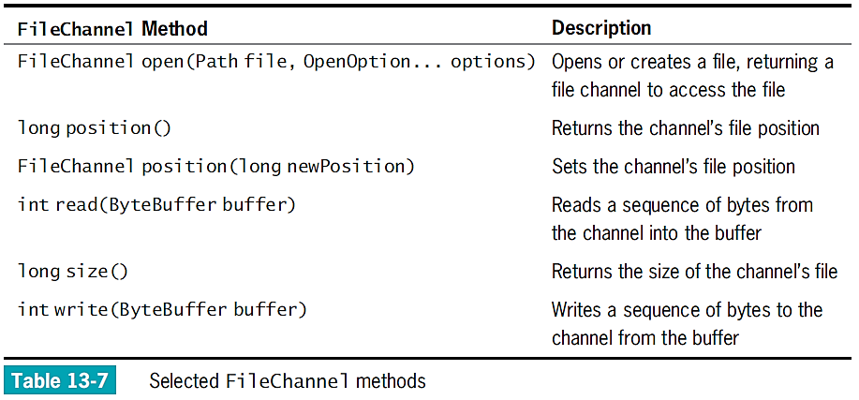
Learning About Random Access Files

Slide 33
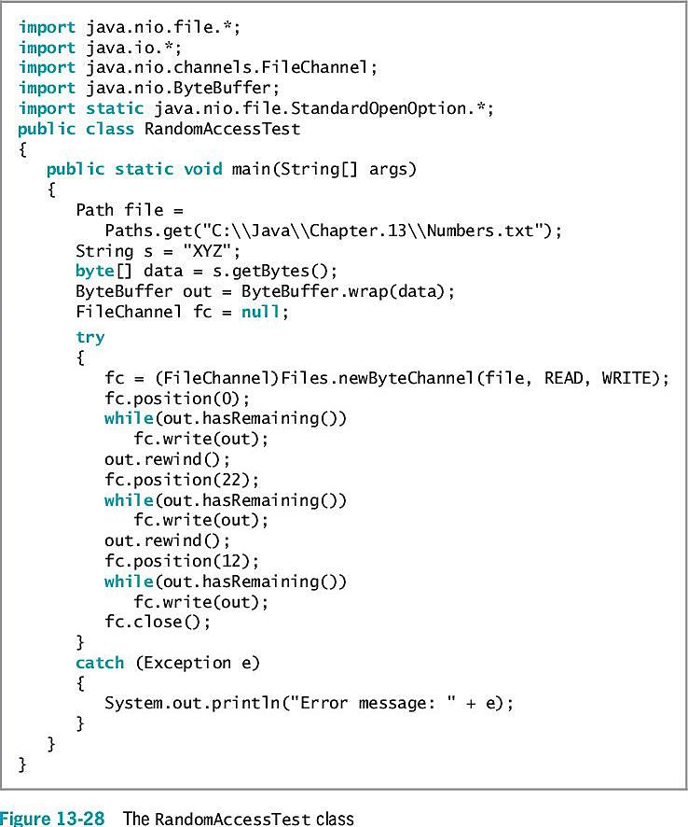

Slide 34
Writing Records to a Random Access Data File
Access a particular record
fc.position((n-1) * 50);
Place records into the file based on a key field
Key field
A field that makes a record unique from all others

Slide 35
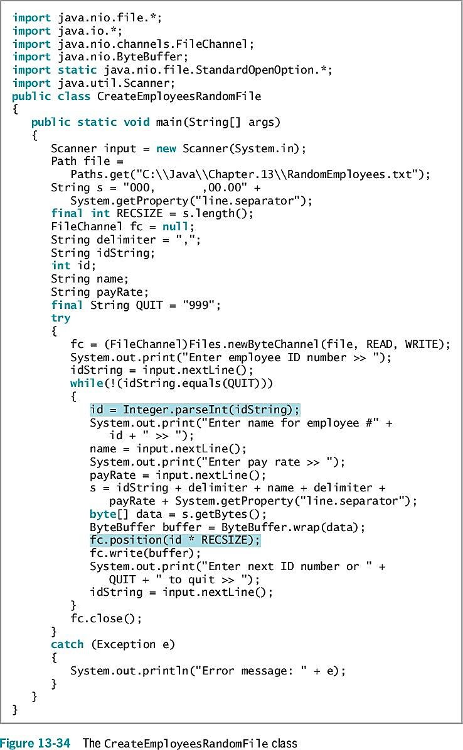

Slide 36
Reading Records from a Random Access File
You can process a random access file either sequentially or randomly

Slide 37
Accessing a Random Access File Sequentially
ReadEmployeesSequentially application
Reads through 1,000-record RandomEmployees.txt file sequentially in a for loop (shaded)
When ID number value is 0:
No user-entered records are stored at that point
The application does not bother to print it

Slide 38
Accessing a Random Access File Randomly
To display records in order based on the key field, you do not need to create a random access file and waste unneeded storage
Instead, sort the records
By using a random access file, you retrieve specific record from the file directly without reading through other records

Slide 39
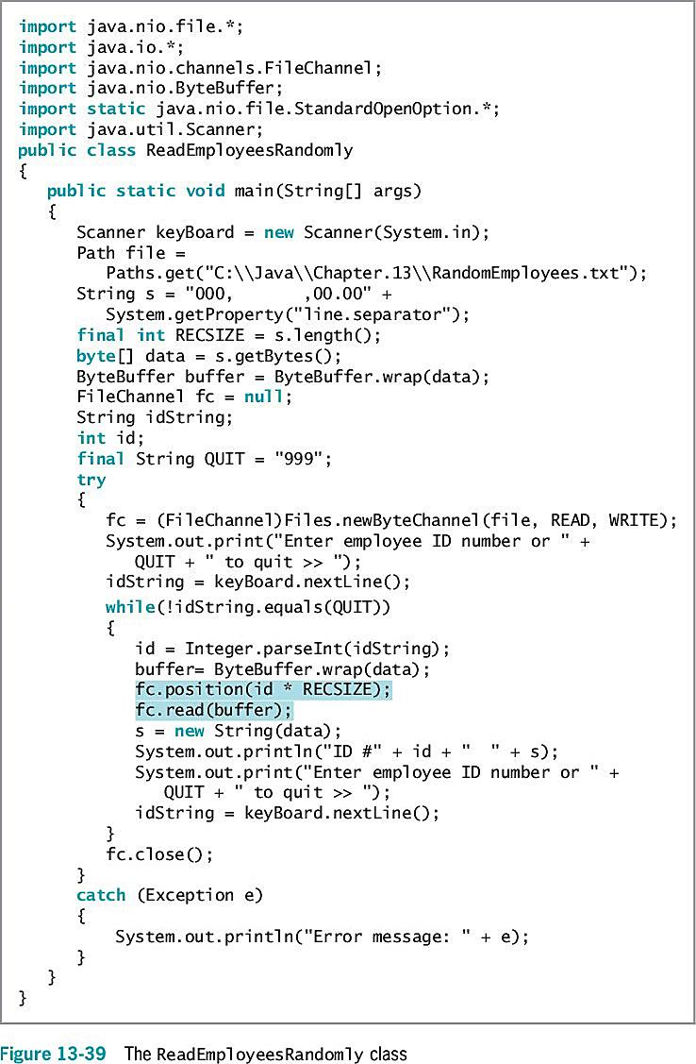

Slide 40
Don’t Do It
Don’t forget that a Path name might be relative and that you might need to make the Path absolute before accessing it
Don’t forget that the backslash character starts the escape sequence in Java
You must use two backslashes in a string that describes a Path in the DOS operating system

Slide 41
Summary
Files
Objects stored on nonvolatile, permanent storage
File and Files class
Gather file information
Java views file as a series of bytes
Views a stream as an object through which input and output data flows
DataOutputStream class
Accomplishes formatted output
DataInputStream objects
Read binary data from InputStream
Random access files
Records can be located in any order
RandomAccessFile class
Write objects to files if they implement Serializable interface

Slide 42
Exercise
Write a program that creates a file of items carried by the company from the user’s input. Include a three-digit item number (SKU) and up to a 20-character description of each item. Issue an error message if the user tries to store an item number that has already been used.
Write an application that takes customer orders. Allow a user to enter an item ordered. Display an error message if the item does not exist in the items file; otherwise, display the accumulated order content.

